Slide 1
Become a Volunteer

Slide 2
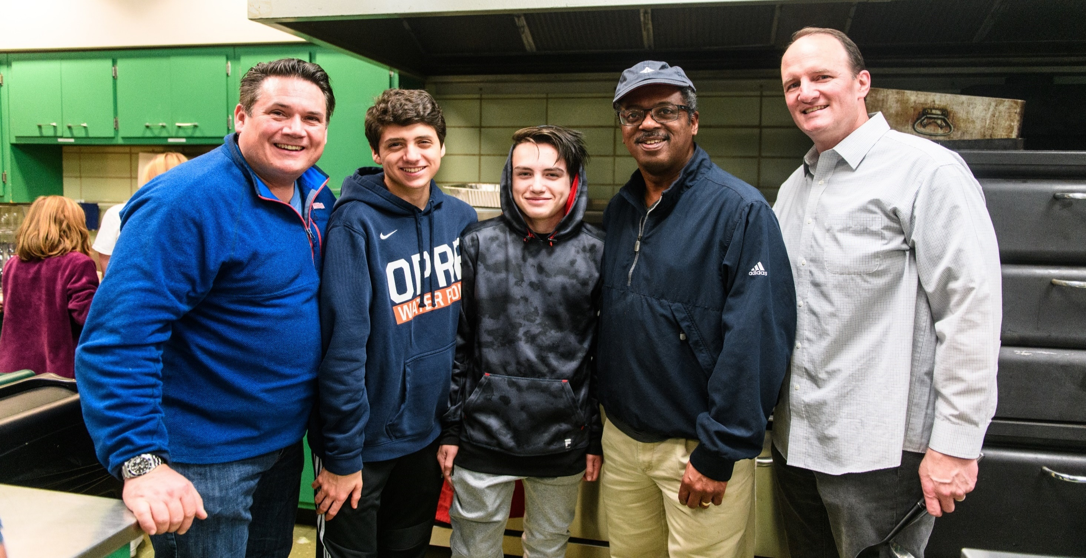
Join Us!
4th Monday Lasagna Team at First United Church of Oak Park
"Never doubt that a small group of thoughtful, committed citizens can change the world, indeed, it's the only thing that ever has." - Margaret Mead
v
v
v

Slide 3
OUR MISSION
to transition people from housing crisis to housing stability.
OUR VISION
to end homelessness.
Our Purpose
v

Slide 4
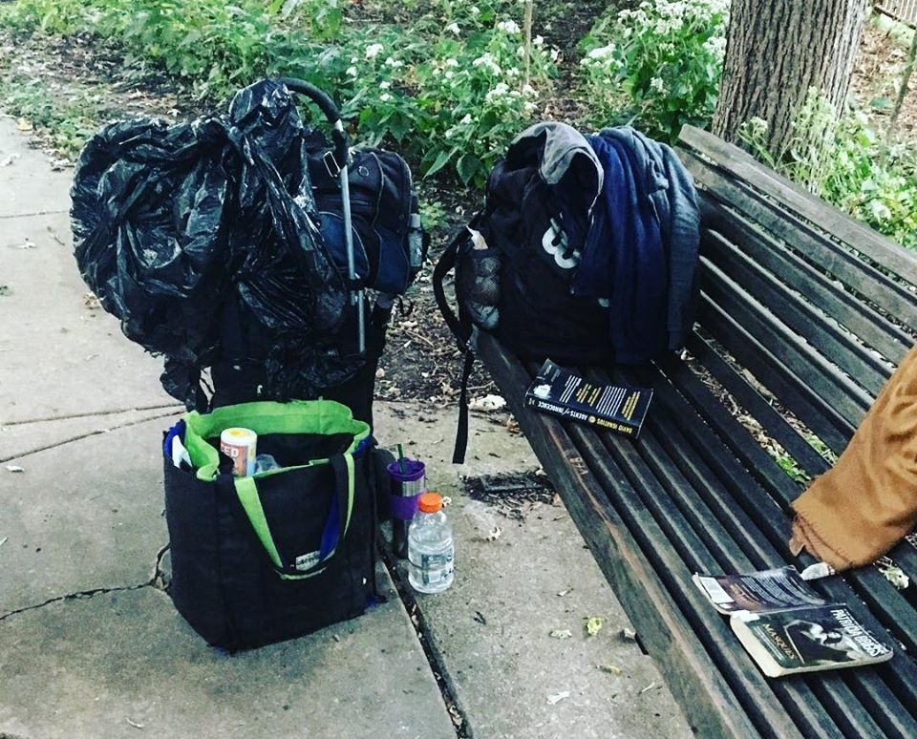
Each year,
Housing Forward
helps more than 2,000 people experiencing homelessness or at risk of becoming homeless.
A housing crisis can affect anyone, at any time.
v

Slide 5
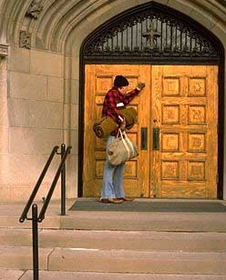
Housing Forward was founded in 1992 by citizens in Oak Park, River Forest and Forest Park who saw a need to meet the basic needs of homeless individuals in the community.
PADS (Public Action to Deliver Shelter) was the model chosen whereby faith communities host the overnight shelter one night each week in dedicated space within their building. Trained community volunteers staff the shelter and prepare meals. That first year 250 volunteers served 120 people needing basic shelter services.
Today, Housing Forward has 1200 volunteers and is the largest provider of homeless services in suburban Cook County providing a full continuum of programming – supportive housing, rapid rehousing, medical respite, homelessness prevention, street outreach, employment readiness, supportive services and of course, emergency shelter services.
Our History
v

Slide 6
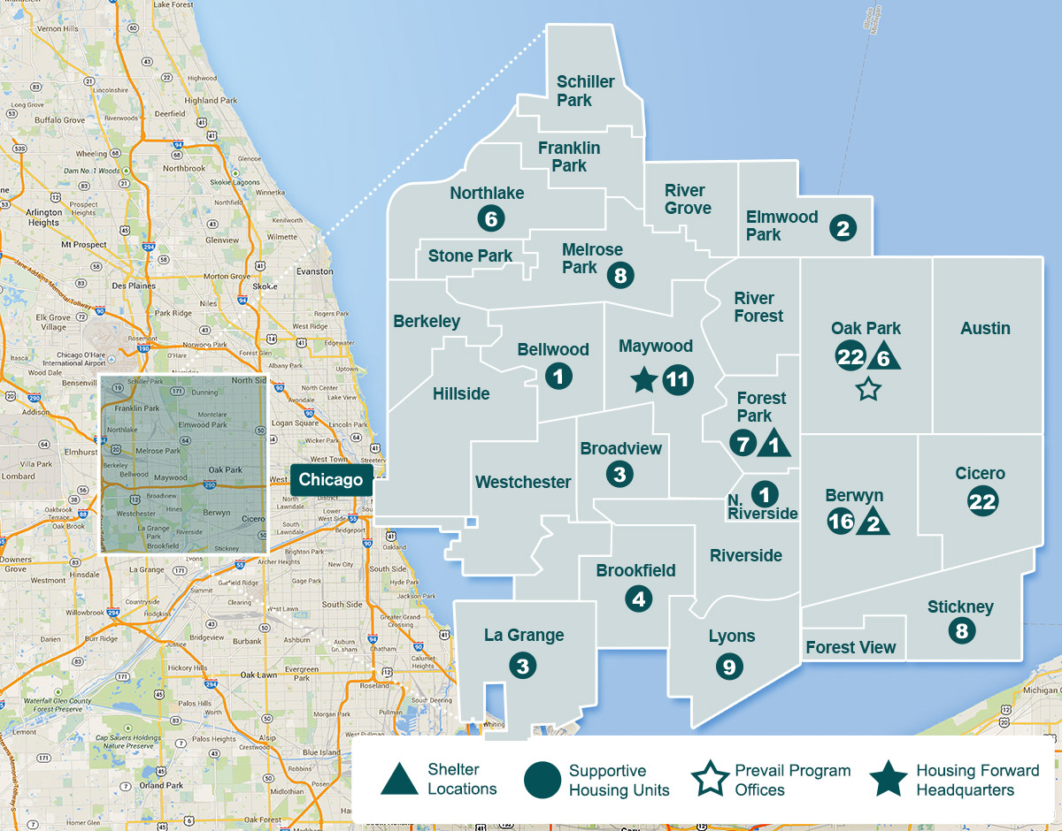
Housing Forward now serves
27 communities
in suburban
Cook County.
Our Service Area
v

Slide 7
Our Approach
v

Slide 8
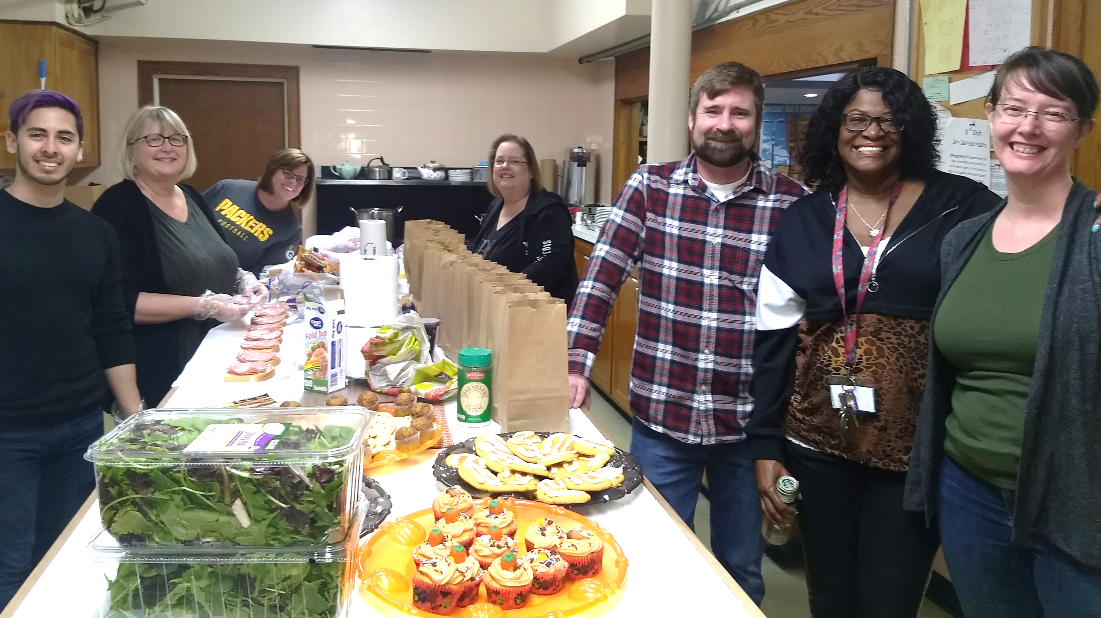
A team packing lunches and serving dinner.
Each year over 22,000 volunteer hours are contributed.
v

Slide 9
https://youtu.be/BsUtqU9ocqc
Why become a volunteer?
v

Slide 10
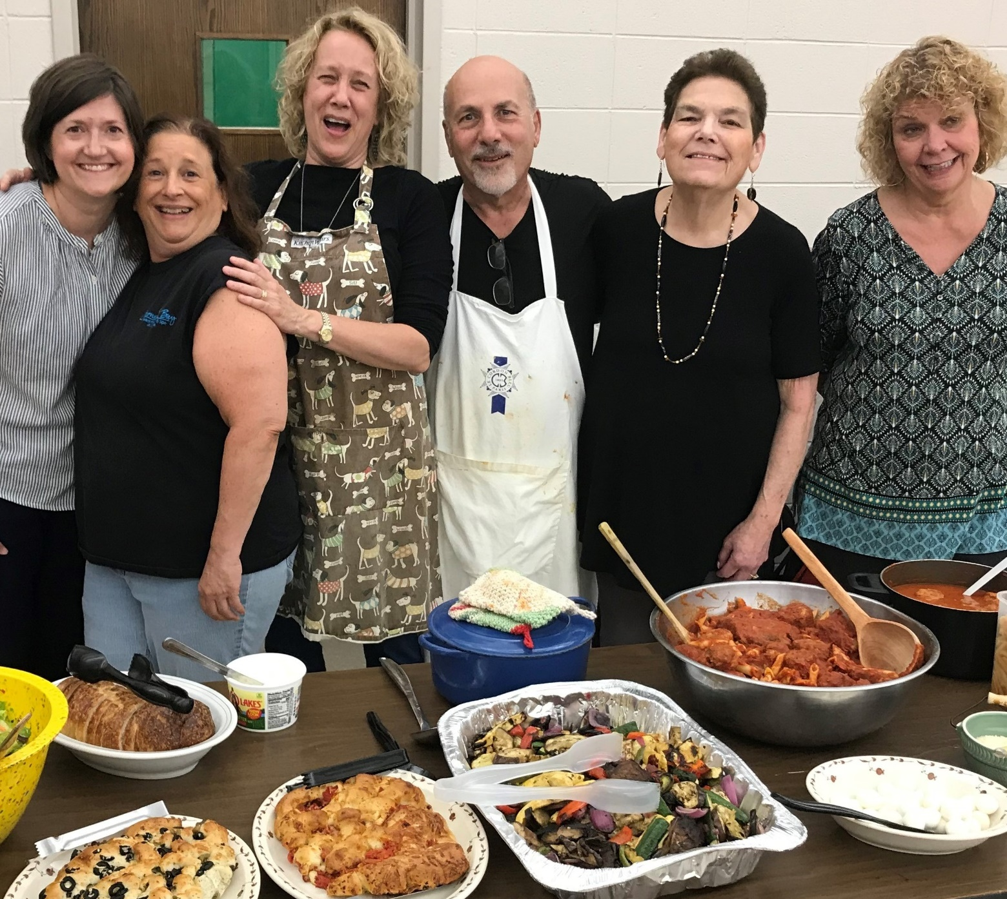
VOLUNTEERS NEEDED:
Individuals
Families
Faith Groups
Civic Groups
School Groups
Corporate Groups
Summer Transitional Shelter dinner providers.
Together we can end homelessness.
v

Slide 11
Client Counselor (skills-based)
Registration Assistant
Administrative Support
Budget Counselor (skills-based)
Short Term Stability (skills-based)
Support Center – reception desk, milieu management
Medical Clinic (skills-based)
Legal Clinic Volunteer (skills-based)
Shelter Site Captain
Meal Provider
Shelter Volunteer
Laundry Transportation
Donation Sorting
Employment Consultant (skills-based)
Computer Specialist (skills-based)
Volunteers help in many ways.
v

Slide 12
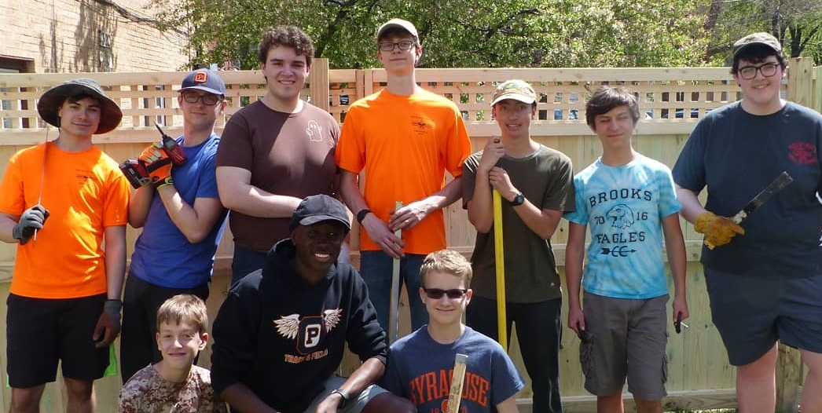
Scouts from Troop 16 built the fence at Sojourner House for Eagle Scout badge.
Volunteers work on both one-time and ongoing projects.
v

Slide 13
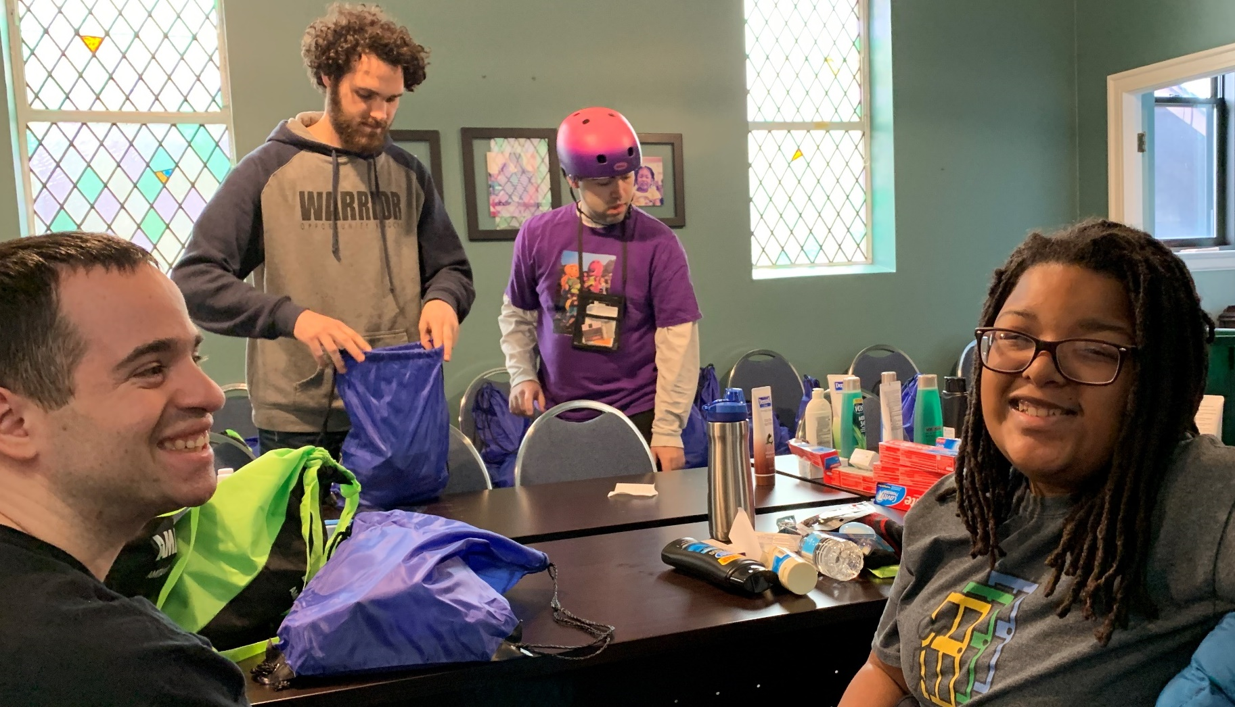
Opportunity Knocks volunteers pack care packages.
No act of service is too big or small.
v

Slide 14
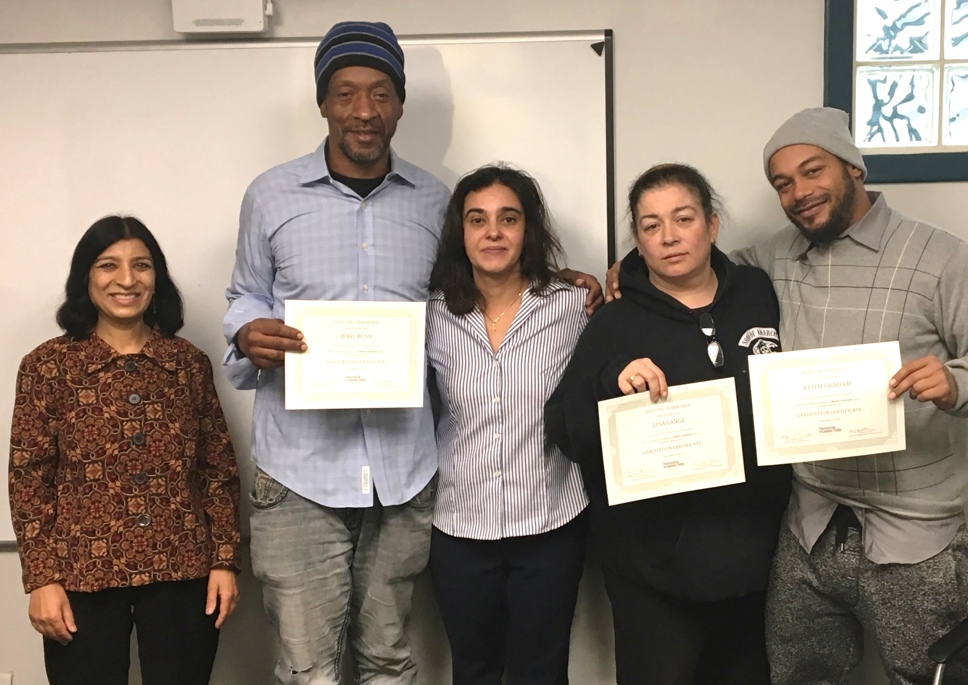
OPPL Librarian Reshima (left) attends a graduation for the Career Passport class she taught job search skills.
With help from hundreds of dedicated volunteers, we provide a safety net for the most vulnerable.
Volunteers contribute time AND skills.
v

Slide 15
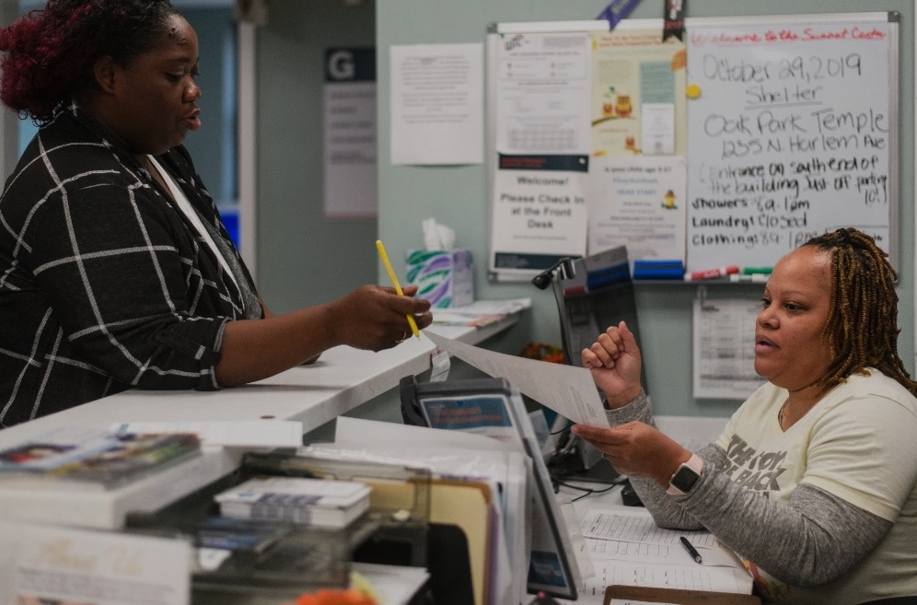
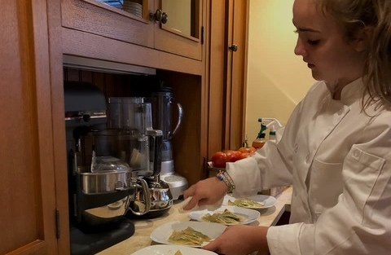
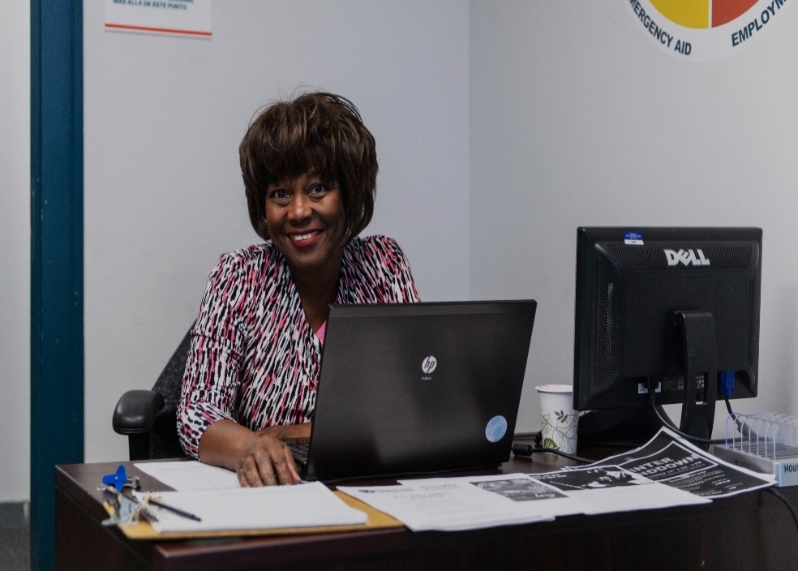
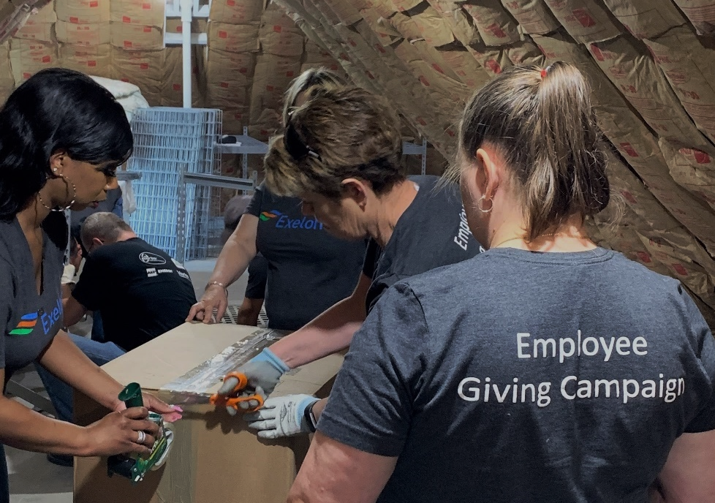
PADS
Shelter
Support Services
One-time Events
Emergency Assistance
Employment Readiness
Corporate Groups
Where do you want to make a difference?
v

Slide 16
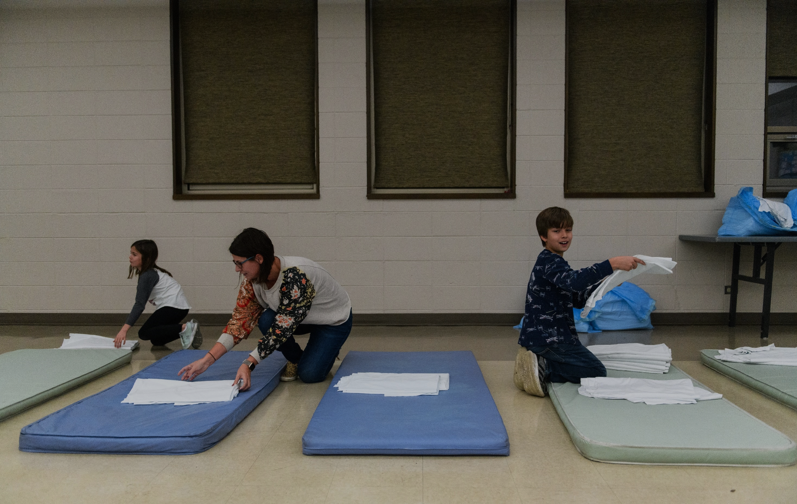
Online Orientation
Complete Volunteer Profile
Attend Training
Placement
v
v
v
1) Complete orientation, 2) decide to advance to next step, and 3) routed to Volunteer Profile.
Complete:
1) Volunteer Profile and
2) background check information
Applicant who has cleared the background check will be contacted for training.
Applicant becomes a Housing Forward volunteer!
Did we convince you? Here’s how it works.
v

Slide 17
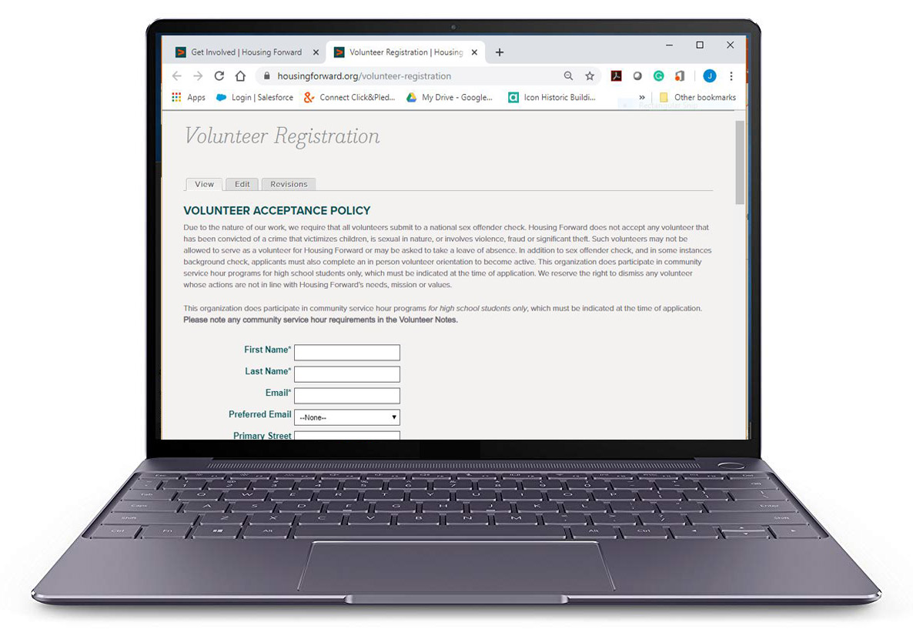
Now that you've completed the Orientation to know more about us, we’re excited to get to know you.
Please click here to complete our Volunteer Profile Form (It takes less than 5 minutes.)
Our staff will contact you to discuss a placement that matches our needs with your interests and availability.
Interested? Great!
Let's complete your Volunteer Profile Form.
v

Slide 18
Thank you
for completing your profile.
We look forward to working alongside you, to end homelessness.
More questions?
Contact Volunteer Services at 708.338.1724 ext. 220 or volunteer@housingforward.org

